Slide 1
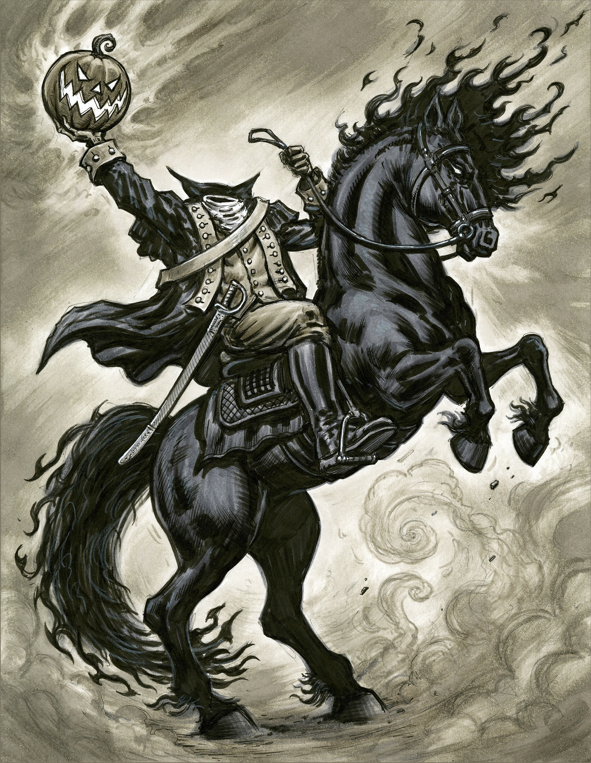
The Headless Horseman of Chatterbox Falls

Slide 2
Log Line:
In 1880s America, a headless horseman disrupts the city father’s attempt to move a cemetery. The fathers hire a tracker to hunt the horseman down.

Slide 3
Beginning: In 1880 rural America, a young girl sees a Headless Horseman gallop across her father’s fields. She races home, discovers the Headless Horseman in her kitchen, and tells her father he looked convincing. Even knowing who he was, she was scared. Dad tells daughter her mother’s resting place will remain sacred.
Middle: As the city Councilmen begin a process of moving a graveyard in order to make way for an electric company that will light the city, the Headless Horseman apears, scaring the daylights out of them and warning them to stop.
End: The city council hires a tracker who swears he will hunt down the horseman and destroy him.

Slide 4
Beats

Slide 5
In 1880 rural America, at dusk, a young girl crosses an empty field

Slide 6
In 1880 rural America, at dusk, a young girl crosses an empty field.
At the sound of a galloping horse, she turns. She watches something, terrified.

Slide 7
In 1880 rural America, at dusk, a young girl crosses an empty field.
At the sound of a galloping horse, she turns. She watches something, terrified.
A headless horseman gallops at full speed across the far side of the field.

Slide 8
In 1880 rural America, at dusk, a young girl crosses an empty field.
At the sound of a galloping horse, she turns. She watches something, terrified.
A headless horseman gallops at full speed across the far side of the field.
The girl turns, gasping, and races toward a house, which looks too far away.

Slide 9
In 1880 rural America, at dusk, a young girl crosses an empty field.
At the sound of a galloping horse, she turns. She watches something, terrified.
A headless horseman gallops at full speed across the far side of the field.
The girl turns, gasping, and races toward a house, which looks too far away.
The girl bursts into the house and runs to the kitchen, only to see the HH sitting there.

Slide 10
In 1880 rural America, at dusk, a young girl crosses an empty field.
At the sound of a galloping horse, she turns. She watches something, terrified.
A headless horseman gallops at full speed across the far side of the field.
The girl turns, gasping, and races toward a house, which looks too far away.
The girl bursts into the house and runs to the kitchen, only to see the HH sitting there.
“Father,” the girl says, “you gave me such a fright. And I knew who you were!”

Slide 11
In 1880 rural America, at dusk, a young girl crosses an empty field.
At the sound of a galloping horse, she turns. She watches something, terrified.
A headless horseman gallops at full speed across the far side of the field.
The girl turns, gasping, and races toward a house, which looks too far away.
The girl bursts into the house and runs to the kitchen, only to see the HH sitting there.
“Father,” the girl says, “you gave me such a fright. And I knew who you were!”
The girl helps her father unbutton the coat. He extracts himself from the costume.

Slide 12
In 1880 rural America, at dusk, a young girl crosses an empty field.
At the sound of a galloping horse, she turns. She watches something, terrified.
A headless horseman gallops at full speed across the far side of the field.
The girl turns, gasping, and races toward a house, which looks too far away.
The girl bursts into the house and runs to the kitchen, only to see the HH sitting there.
“Father,” the girl says, “you gave me such a fright. And I knew who you were!”
The girl helps her father unbutton the coat. He extracts himself from the costume.
He seems a gentle soul, a loving father.
He tells his daughter that her mother will continue to rest in peace

Slide 13
Where are we?
EXT. FARM FIELD – DUSK
The field, now only stubble, is bordered by a dense stand of timber. The sun has recently set, and pink-tinged clouds fade in the blue sky.
Words appear on the screen: “Rural New York, 1880.” The words fade.
A young girl, MAGGIE, eight, scans the far side of the field, as if looking for something.
From behind her comes the sound of a horse approaching at full gallop.
Maggie turns, her face becoming a mask of terrified shock.
On the far side of the field near the tree line, a black horse gallops into view. Its rider wears a trench coat with a wide collar—and has no head.
The HEADLESS HORSEMAN raises a fist as he gallops by and cries: Woe to any who defile my grave!
Maggie turns and races toward a farmhouse at the end of the field, a cozy little cabin with lights on and smoke curling from the chimney. The farmhouse seems a long way off.

