Slide 1

How to Independently Publish an Anthology
(or novel, or anything else)
Presented by
Jim Tritten and Patricia Walkow
The Corrales Writing Group
Copyright © Corrales Writing Group LLC, 2014, 2017

Slide 2

What is an Anthology?
Definition:
An anthology is a collection of work published as a single entity.
Copyright © Corrales Writing Group LLC, 2014, 2017

Slide 3
Common Models of Anthologies
SINGLE AUTHOR | Single Topic | Multiple Topics
MULTIPLE AUTHORS | Single Topic | Multiple Topics

Slide 4
Single Author Model
Single Topic - Cats
Cat story 1
Cat story 2
Cat story 3
Cat story 15
Single Topic - Pets
Cat story 1
Cat story 2
Dog story 1
Bird story 1
Horse story 1
Mixed Anthology – Multiple topics
Memoir 1
Fiction story 1
Pet Story 1
Fiction story 2

Slide 5
Multiple Author Model
Single Topic - Cats
Cat story 1
Cat story 2
Cat story 3
Cat story 15
Single Topic - Pets
Cat story 1
Cat story 2
Dog story 1
Bird story 1
Horse story 1
Mixed Anthology – multiple topics
Memoir 1
Fiction story 1
Pet Story 1
Fiction Story 2
Author biographies

Slide 6
Standards
FONT and Font SIZE
Margins
Paper Size
Title format consistency
Page number consistency
Indentation consistency
Text break consistency
Photo resolution
Photo and illustration captions
Attributions

Slide 7
Standards, continued
Spelling out/not spelling out numbers
How to indicate time (a.m., p.m.)
Proper use of different kinds of dashes
Use of ellipsis . . .
Corrales Writing Group Standards
Chicago Manual of Style

Slide 8
Anthology Model Comparison
Single Author Model
Multiple Author Model
No need to organize, verify, and
edit the work of others
Great temptation not to have
your work edited and reviewed
by others
Promotes lackadaisical
approach to a meeting a solid
publication date
Author blindness to own work
Editor role needed to manage
and review the work of all
authors
Creation and enforcement of
a project schedule
Clear identification of roles in
the anthology review and
production process, with clear
accountabilities
Varying competency levels using
Word can create excess work for
editor

Slide 9
Required Competencies
Basic Competencies for all authors in the anthology - whether it is one or more authors
Medium to high level Competency in use of Microsoft
Word or some other word processor all authors in the
group understand
Competency in the use of e-mail and attachments
Commitment to adhering to a project schedule
Commitment to participating in the PROOF review process

Slide 10
More about Competencies
Not all authors need the exact same level of competencies,
although they do need to have the same kind of competencies (using a
word-processing program, for example. Some will be better at it than
others).
One or two in a group should be very comfortable with
software and computers
Otherwise, there is another option, called “Hiring an Expert”

Slide 11

Publishing Options
Traditional Publishers - unrealistic
Subsidy Press [e.g. Arcadia] – unexpected costs and obligations
Independent Publishing [Indie] - affordable
Print version - affordable
Electronic [Kindle] - affordable
Audio – expensive even if you try it yourself

Slide 12
Independent Publishing [Indie]

Slide 13
The Indie Publishing Process
The Vendor Process
Picking a Vendor
  CreateSpace
Metadata
Cover Selection
Front Matter
Review Process

Slide 14
Picking a Vendor
Many vendors are in the marketplace. Analyze which is best for your situation
  Blurb, CreateSpace, Lulu, Xlibris
    Different vendors have different rules
    Differences in cost
    Differences in requirements for book length, often 20-800 pages

Slide 15
The Vendor Process
Who can print my book?
  What can they do for me?
What do they want from me?
  Front matter
  Manuscript
  Proofing and timing
How much does a finished book cost to be shipped to me?

Slide 16
CreateSpace
The Corrales Writing Group chose CreateSpace, an online tool for creating a book.
Easy to use – steps the author through the process of
creating a book
Free unless you order proof copies
Good options – color vs. b&w, paper choice
choices, size choices, cover options, distribution
channels
Totally integrated with Kindle Direct Publishing (KDP) and Amazon.com

Slide 17
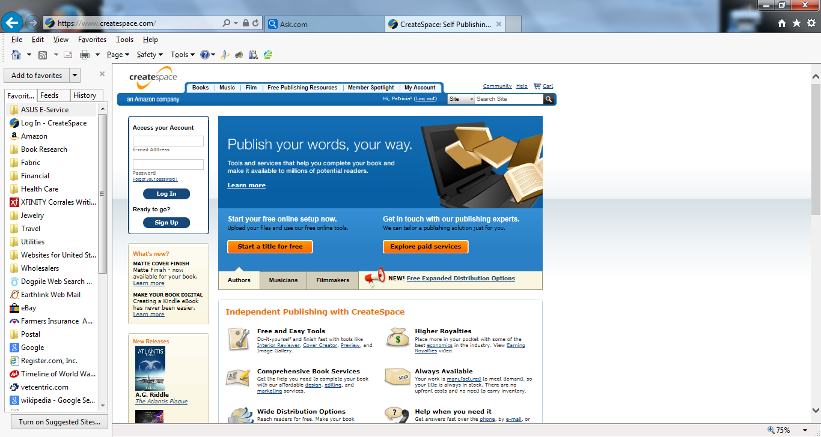
CreateSpace Opening Screen

Slide 18
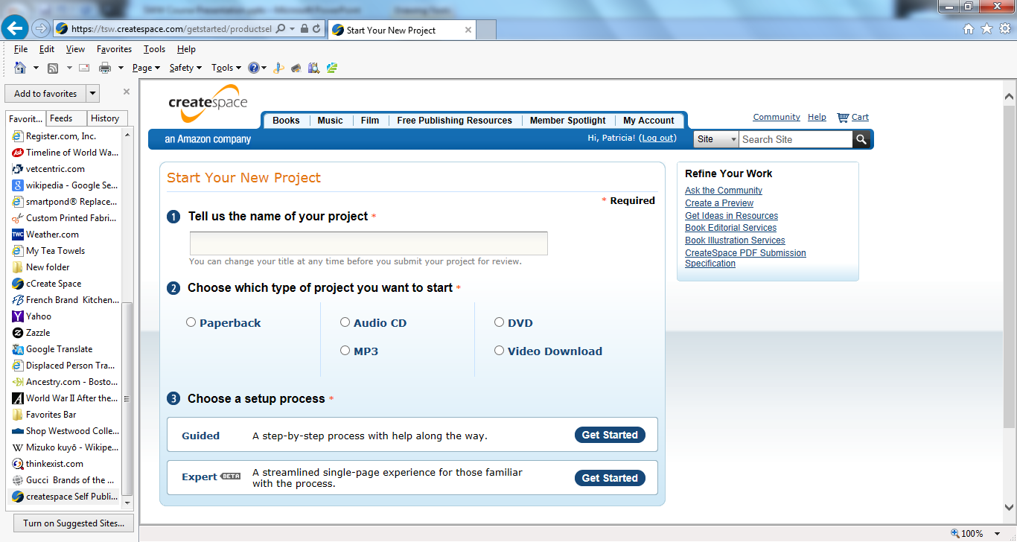
CreateSpace Set Up Screen

Slide 19
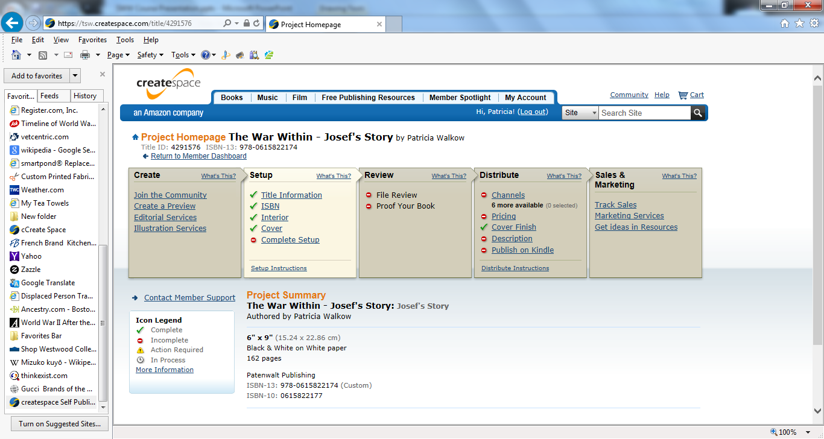
CreateSpace Project Homepage

Slide 20
Metadata
Metadata
  Metadata are keywords that make it possible
  for someone to search for your book online
  Drives those automatic
  “we think you’d like…”
  at the bottom of your
  Amazon page

Slide 21
Cover Selection
Image & Title
Cover Selection
Pick a high definition photo that will wrap
around front and back cover
Use vendor-supplied cover templates
Create a custom cover using the vendor’s
customizable template

Slide 22
Front Matter
Copyrighting ©
Copyright your work to protect it from plagiarism
What to include in the copyright information
    copyright symbol, name, date, and appropriate text
    about ownership of the work
You can also file with the Library of Congress
ISBN / ASIN Numbers
Assigns a unique ID to the book
Required by Amazon, libraries, and bookstores

Slide 23
Review Process
You can review a paper book online.
DO NOT assume what you see on the screen is exactly what will print.
Upload color photos but make sure first they will print well in black & white.
You can order paper proof copies at a modest cost.
You must review an e-book online. And you must review it in all possible formats.

Slide 24
Closing Comments
Indie-publishing GUARANTEES publication
Indie-publishing levels the playing field
No more rejection slips!
Choose a model
  We chose geographic commonality for our anthology
Leave a legacy
Financial viability can be achieved
AND………………………………………………………………

Slide 25

Don’t be
Afraid!!

Slide 26
QUESTIONS ??????
MY BOOK

